Slide 1
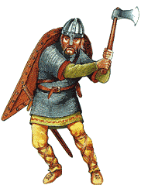
If you lived in Beowulf’s society…

Slide 2
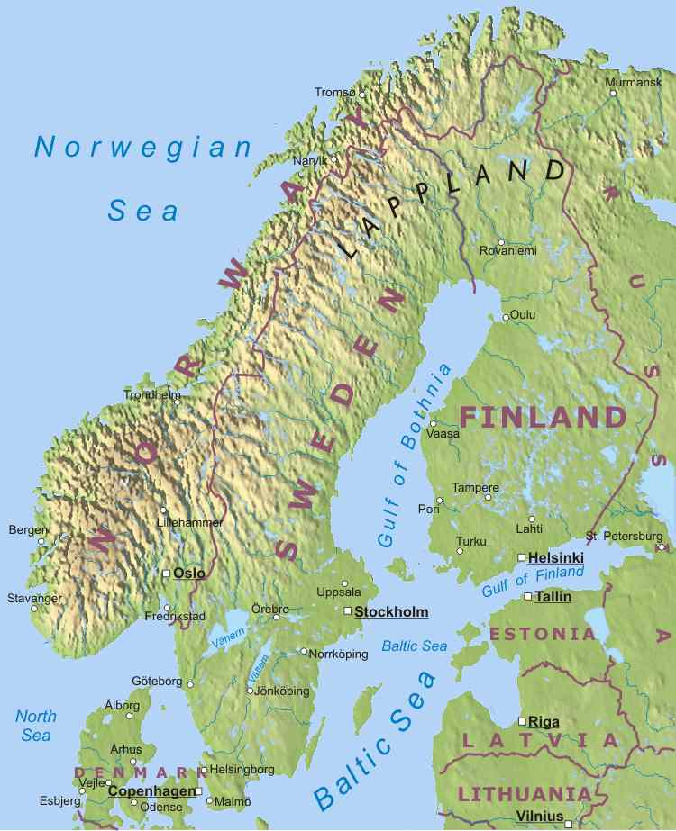
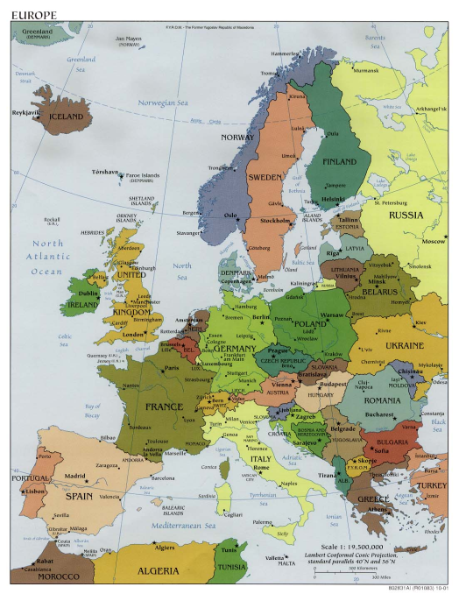
If you lived in Beowulf’s society…
You would have been called an Anglo-Saxon.
You would have been alive between 400 and 1000 AD.
You would have lived in Scandinavia (the Sweden/Finland/Norway/Denmark area).
Around here in Europe

Slide 3
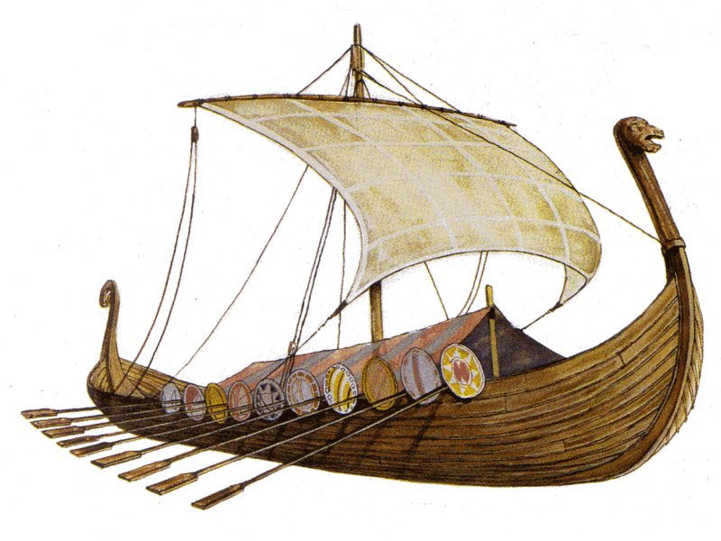
You’d cruise around in a boat called a drakkar.

Slide 4
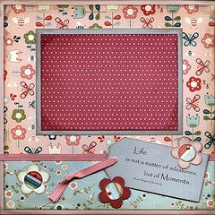
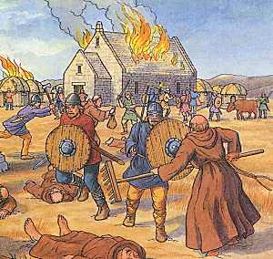
You and your buddies would sail around looking for monasteries to raid (that’s who had the loot back then).
April 7, 498
Raiding the monastery with the guys. Ah, the good ol’ days.

Slide 5
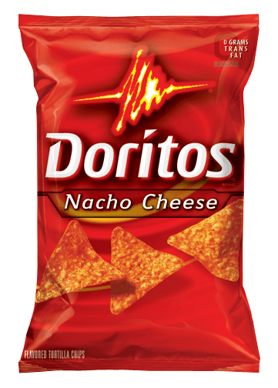
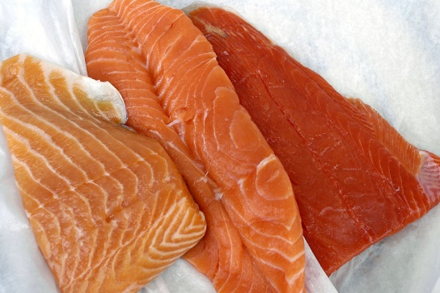
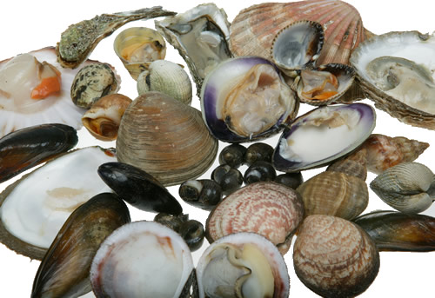
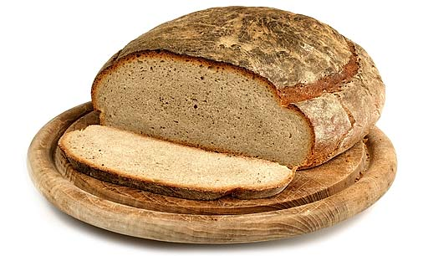
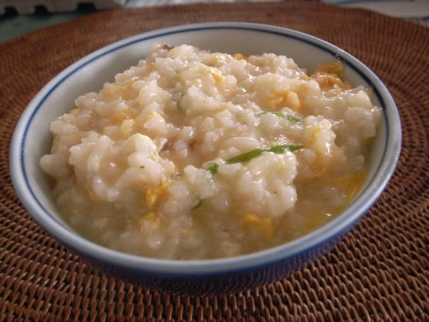
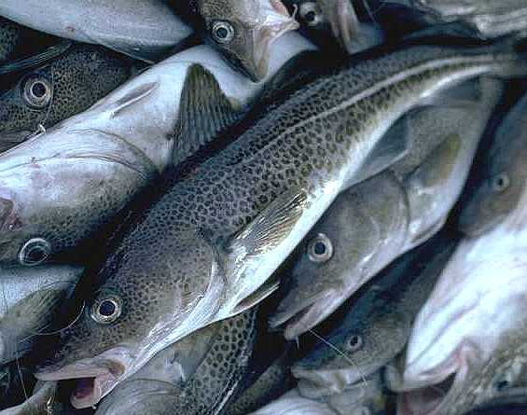
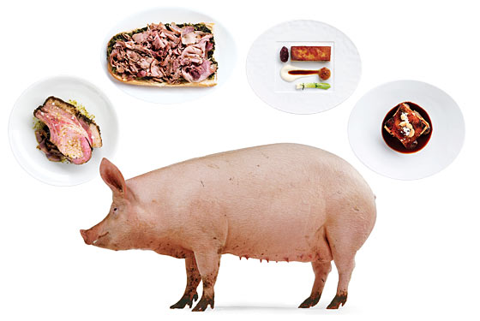
Want a snack?
Here are your choices:
“Warning: Eating raw or uncooked meats, poultry, seafood, shellfish or eggs may increase your risk of foodborne illness.”

Slide 6
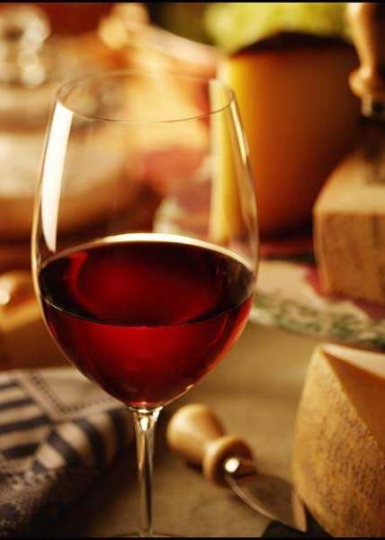
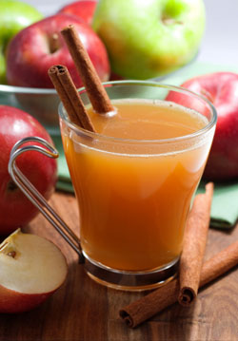
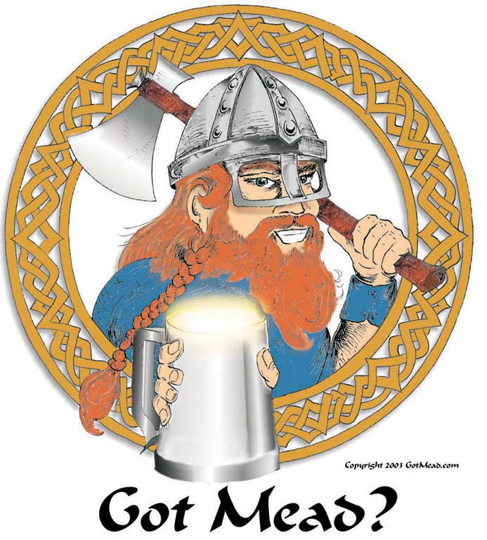
Water quality is questionable, so you’d probably drink this:
Wine
Hard cider
Mead (A sweetened predecessor of beer)

Slide 7
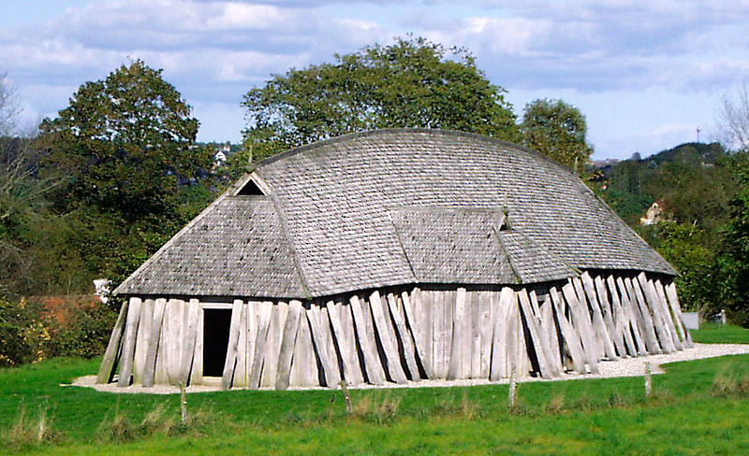
You’d eat and party with your friends at the mead-hall. This is also where village business would occur (like “town meetings”). The king and other important people might live here. It might be used as a fort.

Slide 8
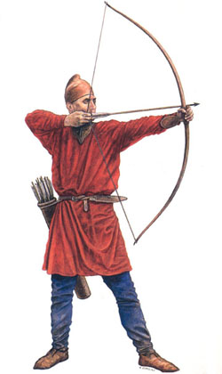
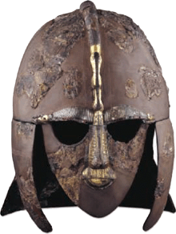
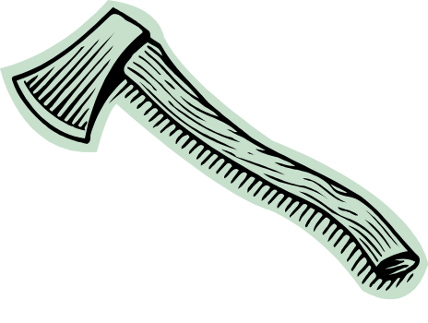
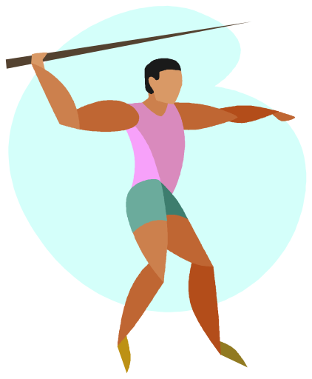
You’d probably know some serious battle skills.
Yup, that’s a mustache.
Axe-throwing
Real Anglo-Saxon helmet unearthed at Sutton Hoo, a burial site in England
Bow and arrow
Javelins were used as weapons.

Slide 9


You’d worship many gods that correlate with our modern days of the week.
Monday = day of the moon
Tuesday = the god Tiw
Wednesday = the god Woden
Thursday = the god Thunor
Friday = the goddess Friga
Saturday = Roman god Saturn
Sunday = the day of the sun

Slide 10
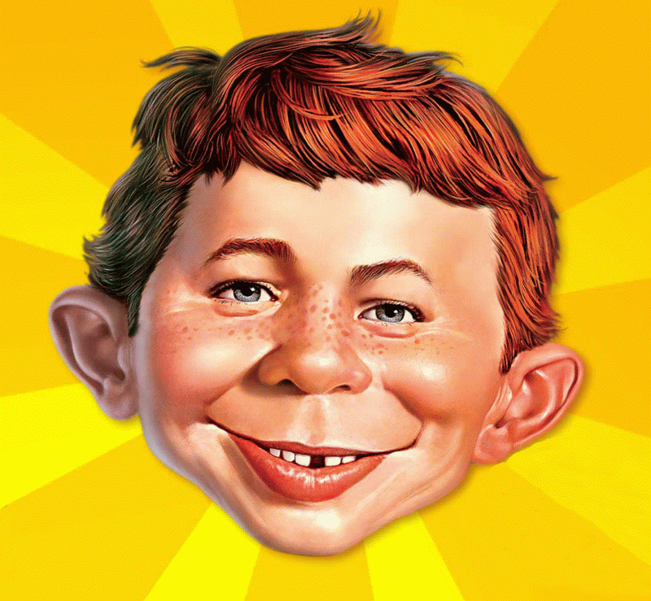
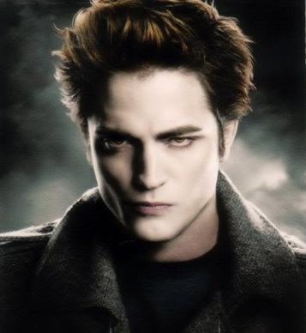

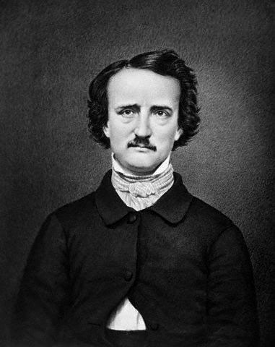
You’d hang out with people named Alfred, Agatha, Edward, Harold, Matilda, Erik, and Edgar.

Slide 11
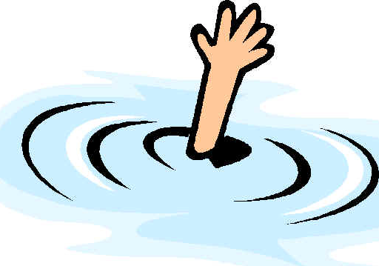
Swimming games would be a big part of your leisure time.
Competitions to drown an opponent
  You know, just typical weekend stuff
Challenges of swimming in armor
Breath-holding contests

Slide 12
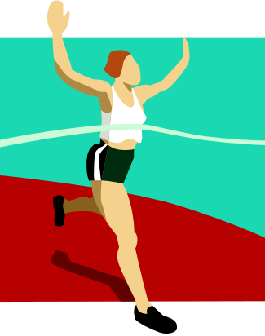
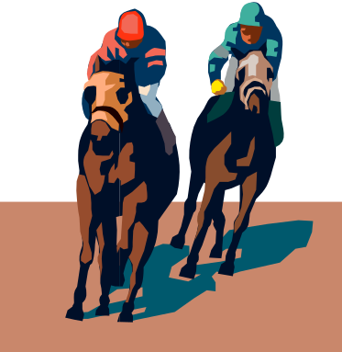
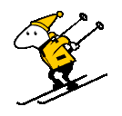
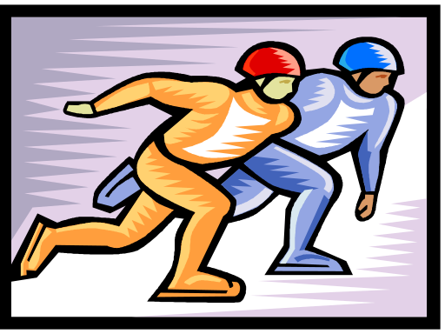
You’d also do these sports:
Running races
Horse racing
Speed skating (using blades made of bone)
Skiing

Slide 13
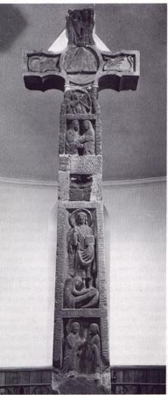
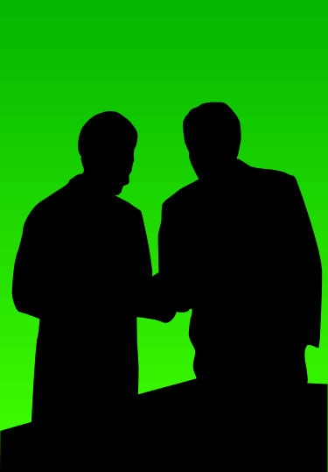
You’d just be hearing about a new religion called Christianity.
What would Jesus do?
I don’t know. Who’d you say he was again?
We see the old beliefs in traditional Norse gods/religious practices and the new beliefs in Christianity intersect in Beowulf.

Slide 14
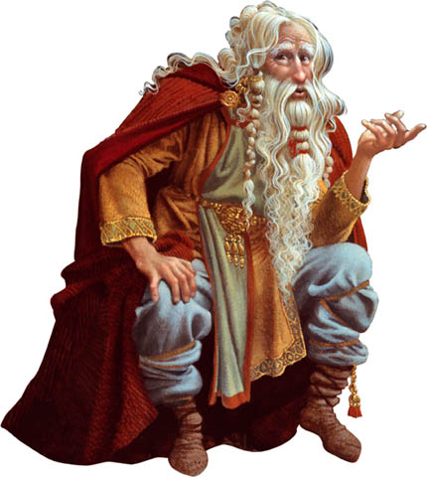
You’d learn about the world, life lessons, and your society’s values from a village storyteller…which is how the tale of Beowulf was spread.

Slide 15

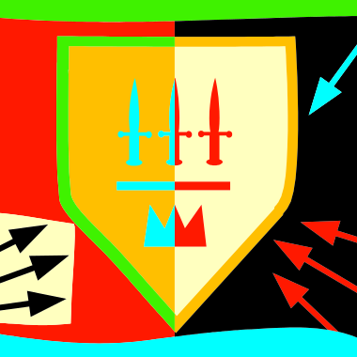
Beowulf
Notes on Anglo-Saxon society and poetic devices

Slide 16
Beowulf
Beowulf is an ancient epic poem.
The character of Beowulf is a hero who exemplifies bravery and goodness.
  People especially appreciate him for fighting off the monsters who threaten their lands!
We don’t know who first created the story of Beowulf because it was told aloud for a long time before it was written down.
  So it’s important to understand more about the history of the culture and era that created it…

Slide 17
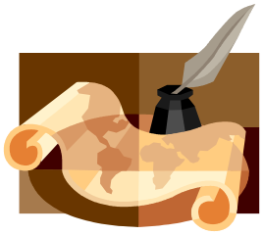
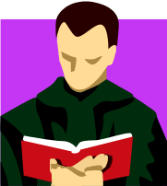
Language History
The English language is divided into three periods: Old English (449-1100 Common Era), Middle English (1100-1500), and Modern English (1500-Present).
We, as Modern English speakers, would not be able to understand Old English. It sounded different, and used some different letters from the runic alphabet. Some of these letters included the thorn, wyn, and eth.
Beowulf was probably written between 700-1100 CE, in Old English (which is sometimes called Anglo-Saxon). It was written in England, but takes place in Scandinavia.
  The tribes called the Angles, Saxons, and Jutes migrated from what is now Denmark to what is now England.
The name Beowulf means “bee wolf.” What animal do you think that is?
Notes:
“Bee wolf” means bear!

Slide 18
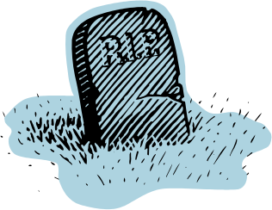

Anglo-Saxon Cultural Terms
(Look for these elements in Beowulf.)
Wyrd: Fate. Anglo-Saxons believed that they were controlled by fate, and, as a result, entered battle without fear.
Thane: A warrior who has sworn his loyalty to a king. He is expected to be brave and courageous.
Comitatus: A code of loyalty. The thane would protect, fight for, and avenge the death of the king if necessary. In exchange, the king would provide all the weapons, food and drink, and gifts the thane needed.

Slide 19
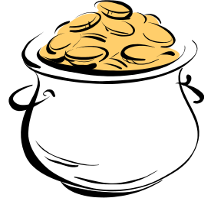
Anglo-Saxon Cultural Terms
Mead-hall: A social center for the immediate community.
Scop (Pronounced “shop”): Storyteller who entertained the court.
Wergild: Translates as “man gold.” A fine paid to the relatives of an injured or murdered person to free the offender from further obligations.

Slide 20
Anglo-Saxon Cultural Terms
Boast: Warriors often made public vows about what they would accomplish before battle. Boasts were considered signs of determination and character, not arrogance or sinful pride.
Flyting: A contest of wit and insults. Each warrior tries to demonstrate his superior vocabulary, cleverness, and bravery.
  Ex: Beowulf has a verbal battle with a man named Unferth, who challenges Beowulf’s qualifications to fight the monster, Grendel.
I heard that your wheat crop FAILED last season!
Well, at least my oxen aren’t SLOW!

Slide 21
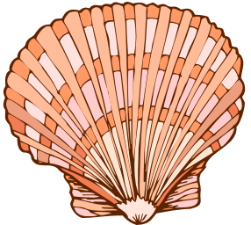
Poetic Elements in Beowulf
Alliteration: Many lines of poetry often contain three to four words with the same consonant sound.
Ex: “A ring-whorled prow rode in the harbor” and
“She sells seashells by the sea shore.”
Caesura: A pause within lines of poetry, which helps with rhythm. It is more obvious in the Old English translation.

Slide 22

Poetic Elements in Beowulf
Kenning: A two-word metaphorical compound that stands for a more common word.
Ex: “Whale-road” is a kenning for the sea.
“Bone-house” is a kenning for ribcage.
Variation: A restatement of a concept using different words. Don’t confuse this definition with the kenning! The variation does not provide a descriptive metaphor. Usually in Beowulf, variation provides us the knowledge of how people are related.
Ex: Beowulf, the son of Ecgtheow (Beowulf = son of Ecgtheow)

Slide 23
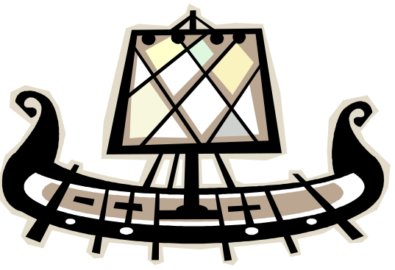
Epic: A long poem centered on a heroic figure whose actions affect the fate of a tribe, nation, or human race.
Epic Characteristics Featured in Beowulf
Universal themes, such as good vs. evil
Hero usually has superhuman traits, greater than the common man.
Setting covers great geographical distances.
Supernatural forces intervene at times.
Ceremonialism: Descriptions center on characters’ armor, the official greeting of kings, and formal celebrations.
Story opens in medias res, which means “in the middle of things.”
Main characters give extended formal speeches.

Slide 24
To note about the first section:
We are given a historical overview of a tribe called the Shieldings (also known as the Danes). This is important because the Anglo-Saxons believed in honoring their ancestors.
  We learn about their original ancestor, Shield, and the generations up to Hrothgar, the current king.
  We learn about their problem with Grendel, the monster who has been attacking their village.
  Beowulf is not yet introduced, so don’t go looking for him! (He comes to help the Shieldings out later.)

