Slide 1
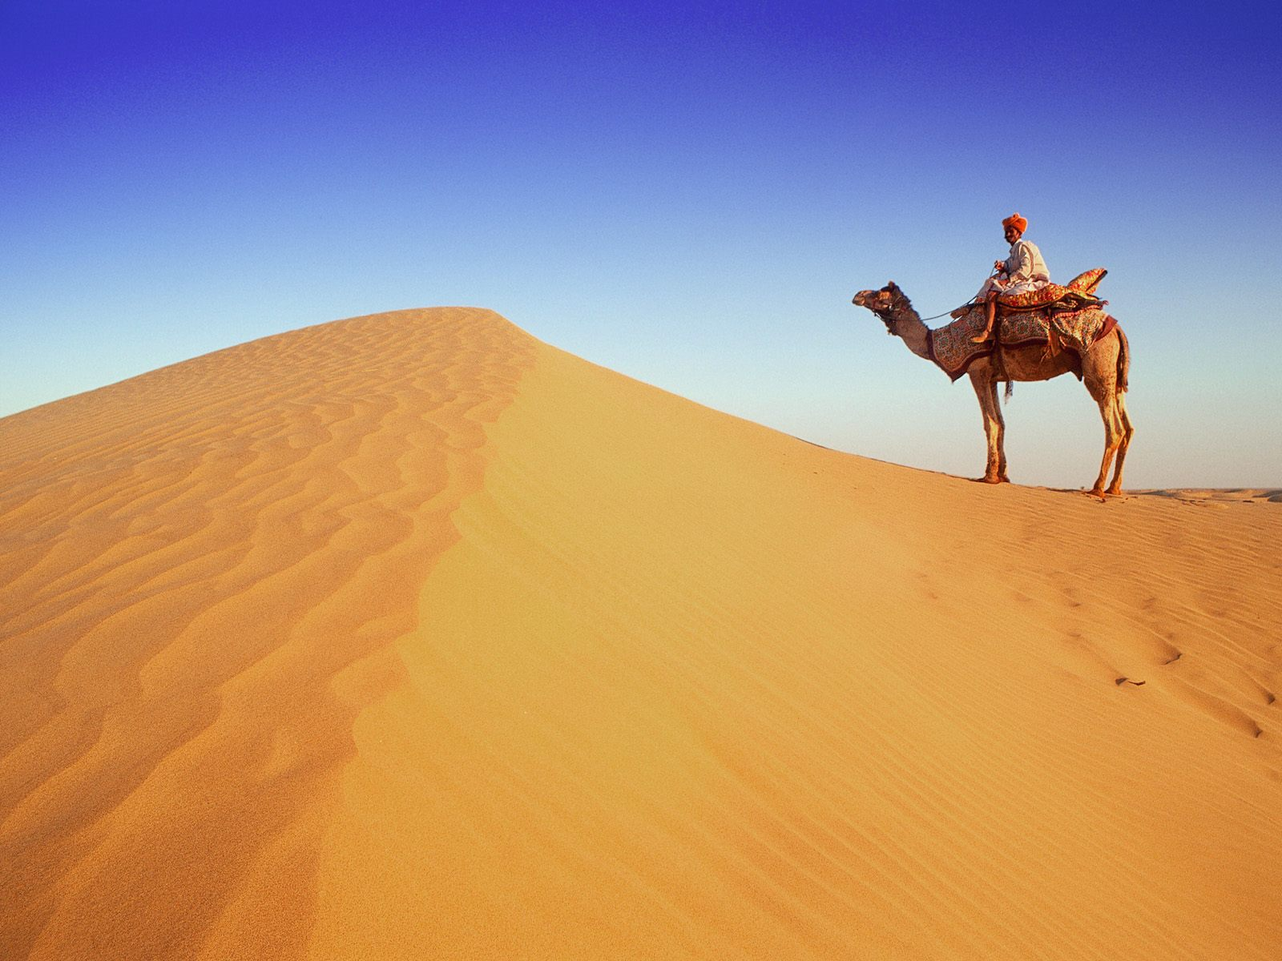
Middle East Background Information
A.D. 500 to A.D. 1500
- Cindy & Dex

Slide 2
Persian and Arabic Literature
In the 7th century A.D., cultures of Arabia and Persia began to flourish due to the impact of Islam.
They advanced intellectually, socially, artistically and technologically.
Their achievements influence modern world like mail service, astronomy, medicine and navigation.

Slide 3
Persian and Arabic Literature
Persia:
  Over 1000 years of history which later on become a major center of Islamic learning.
  The four famous poets are Ferdowsi, Omar Khayyam, Rumi and Sadi.
Arabia:
  Desert peninsula which were inhabited by Arabs that stretches across Asia, Africa and Europe.
  Arabs travel by camel to spread their language and culture far and wide.

Slide 4
Persian and Arabic Literature
Mecca:
  Islam was found in Mecca, by Muhammad.
  He gave Islam the holiest book, the Koran.
Islamic Empire at its peak:
  Muslims spread religion through conquest and persuasion.
  The Islamic empire stretches westward across Africa to Spain and eastward to the Chinese border.

Slide 5
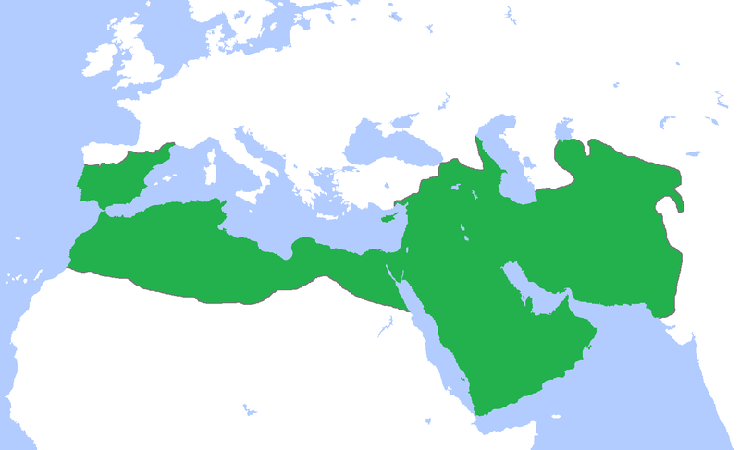

Slide 6
Historical Highlights
Pre-Islamic Persia (1000 B.C. – A.D. 642):
  Persian were originated from Aryan nomads, they settled Persia also known as Iran.
  In 600 B.C., the first religion, Zoroastrianism, was introduced which believe in good and evil.
  Persians expand their territory by warfare under command of Cyrus the Great.
  Standardized weights were introduced in order to promote trade.

Slide 7
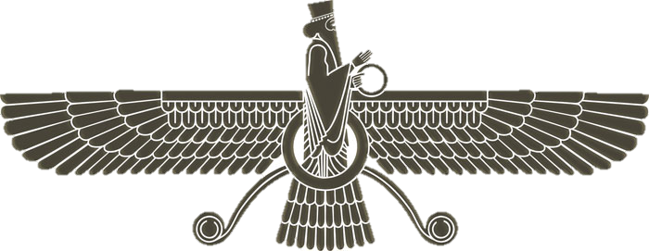

Slide 8
Historical Highlights
Persian Rebirth (A.D. 819-1502):
  In the 9th century: the Samanids gained the power and revived Persian culture.
  Bukhara rivaled Bagdad to become the capital again.
  Persians spoke and wrote Arabic.
  Under the control of Seljiuk sultan, Turkish gained control of Persia until 1502.

Slide 9
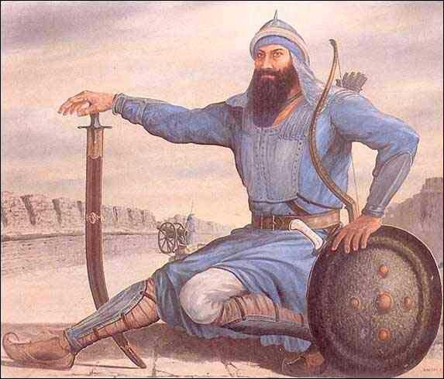

Slide 10
People and Society
Nomads: Known as Bedouins who are wanderers and made up the core of Islamic armies.
The ruling classes: Islamic empire was a theocracy which were govern by religious authority. In the 10th century, with the help from vizier (chief ministers), emirs (princes), sultans (rulers), shahs (kings) start to rule.
The Lower Classes: The poor affected Muhammad’s moral perspective. The poor were treated justly in the society and Islamic promote freeing of slaves. People who converted to Islam need to pay higher taxes than those who were born Muslim.

Slide 11
People and Society
Merchants and Traders: They sold goods outdoor town and market called bazaars or travel by land and sea to trade. They also exchange their knowledge and ideas.
The learned class: These are valued members of the society like scholars, scientists, writers and artists. Got financial support by powerful rulers who were impressed by all of the scientific achievements. The House of Wisdom in Baghdad was a place where scholars come together from different place to exchange ideas.
Islamic Mystics: Religious leader or dervishes, mystic monks who have personal connection with Allah. Many of them associates with an Islamic movement, Sufism. Sufi dervishes live in monasteries while Fakirs, traveling dervishes, live by begging for food.

Slide 12
Women in Islamic World
Lives of women is between in Islamic world since they were given rights to:
  Concern about marriage, family and poverty.
  Women were considered to be equal to men in the eyes of Allah.
  Though, they need to live an isolation lives as time passed.

Slide 13
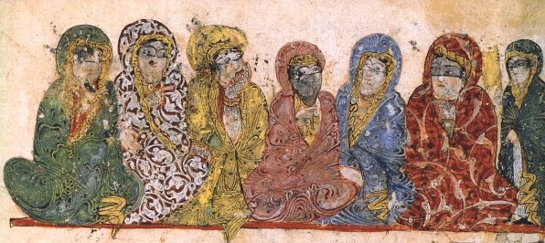

Slide 14
Art and Culture
Islamic Architecture:
  Mosques are Islamic houses of worship with beautiful arched or vaulted walkways. Often carved with lacelike patterns called arabesques.
  Minarets are a high tower next to the central portion of the mosque where criers, Muezzins, come to pray five times a day.
  There are many magnificent palaces such as the Alhambra in Spain which were domed and vaulted.

Slide 15
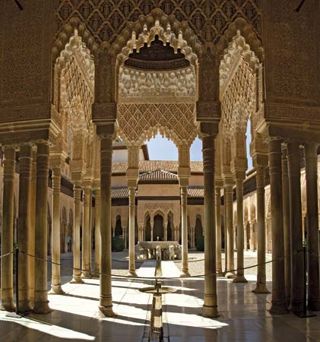

Slide 16
Art and Culture
Scholarship and Science:
  Muhammad encourages study and learning as well as the new cultural contacts Muslims made as their empire expanded.
  Many great universities also promote the study of religion, philosophy, law, and Arabic grammar.
  In the House of Wisdom, major translations were undertaken and many new works of scholarship were written.

Slide 17
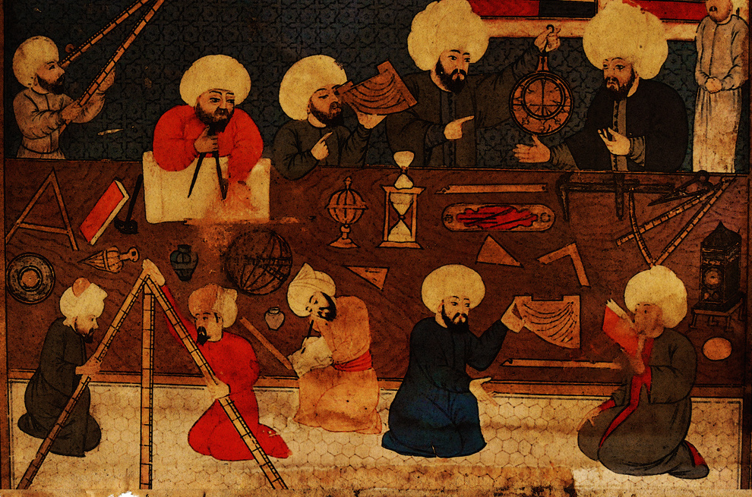

Slide 18
Art and Culture
Literature:
  Arabic Literature:
    Composed mainly of oral tradition. Songs and elaborate odes called qasida were memorized and passed down to the next generations.
    These oral tradition continued on but were also written down as text.
    Arabic literature entered a golden age where many types of literature were created like history, philosophy, science and biology.
  Persian Literature:
    Produced great literature before Islam like the Avesta, Zoroastrian sacred text.
    In the 9th century, native Samanids produced major literary works in Persian as a cultural revival.
    The blending of Persian’s tradition and Sufism resulted with great lyric poetry of the world.

Slide 19
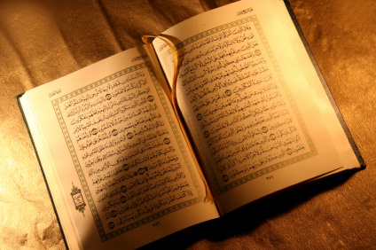

Slide 20
Art and Culture
Decorative Arts:
  Islamic world produced abstract and variety types of arts like carved swords of Damascus to ceramic tiles of Persia.
  Arabesques are abstract designs on buildings, walls, furniture, fabrics, pottery or metalwork.
  Persian miniature paintings were not abstract which depicted people and animals in urban scenes.
  They were mostly used as manuscript illustrations

Slide 21
