Slide 1
Book talks
How to succeed!

Slide 2
Format
You can be creative with your format.
Some suggestions are: a poster, video, Youtube, Screen-cast-omatic, animation, trailer, ppt, handouts, role play or just a speech.
If you want to bring props that would be great!
REMEMBER, you must talk, so if you use a digital format you need to do an introduction or a voice over, in person, to the class.
It should be 2 minutes minimum.

Slide 3
What must it include?
It must have a summary of the plot BUT no spoilers please.
What did you like about it?
What didn’t you like about it?
Who would you recommend it to?
How is it narrated?
What are the general themes?
Who is your favourite character?
What made you choose it?
Will you look for books by the same author?
What genre is it?
Has it helped you decide what to read next?
Did it inspire you to find out more about any issues or events in the book?
Can you sum up the book in three words?

Slide 4
Here’s some good examples.
https://www.youtube.com/watch?v=_nITgYka2Qg
https://www.youtube.com/watch?v=hjygE_6SXBg
https://www.youtube.com/watch?v=ot7T5YTgj6M

Slide 5
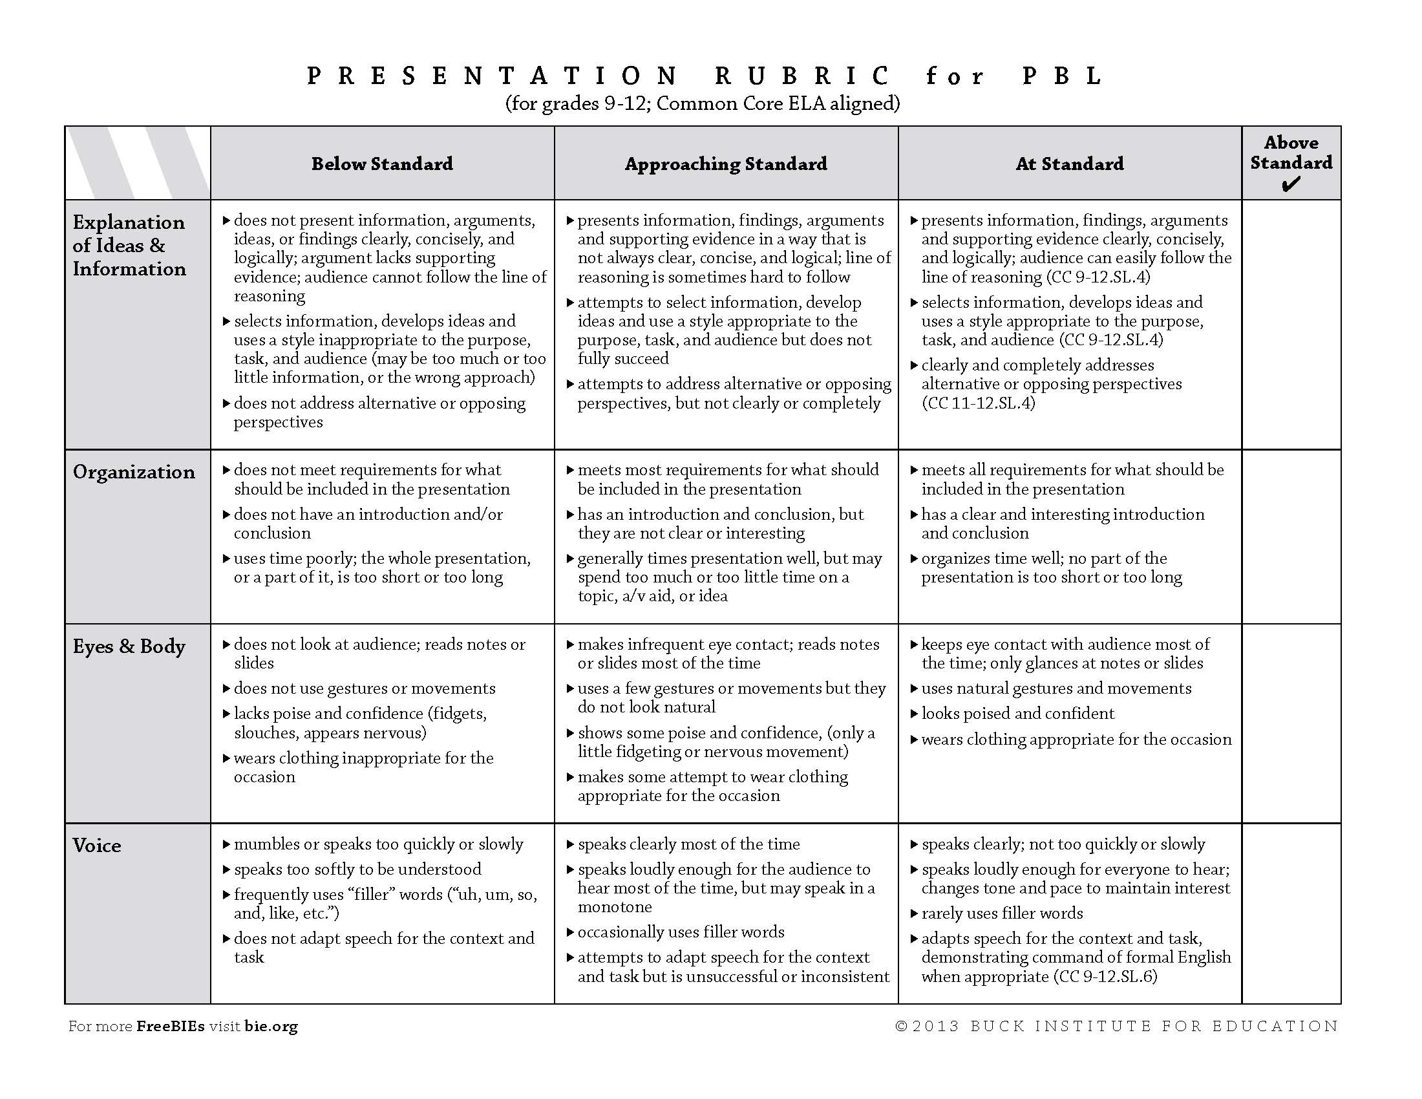
Rubric – out of 12 possible marks

